Slide 1
Cnn architectures
ImageNet Large Scale Visual Recognition Challenge
Gene Olafsen

Slide 2
LeNet-5
1998 created by Yann LeCun for handwritten digit recognition
MNIST digits are padded from 28x28 to 32x32
Complex pooling – computes the mean of its inputs and then multiplies the result by a learnable coefficient (one per map) and then adds a learnable bias term (one per map) and then applies an activation function.
C3 maps don't connect to all previous pooling layers- three or four instead of all six.
The output layer is special... see next slide.

Slide 3
LeNet-5 Output layer
The output layer computes the dot product of the inputs and the weight vector, each neuron outputs the square of the Euclidian distance between its input vector and its weight vector. Each output measures how much the image belongs to a particular digit class.
The cross entropy cost function is now preferred, as it penalizes bad predictions, producing larger gradients and thus faster convergence.

Slide 4
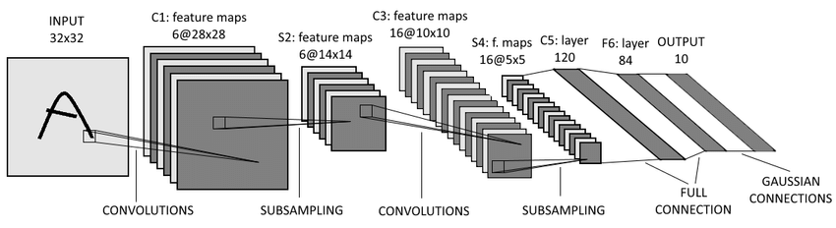
LENET-5
a

Slide 5
ImageNet
The ImageNet project is a large visual database designed for use in visual object recognition software research. The ImageNet project runs an annual software contest, the ImageNet Large Scale Visual Recognition Challenge (ILSVRC).

Slide 6
Alexnet
AlexNet – won the 2012 ImageNet ILSVRC challenge. Developed by Alex Krizhevsky, IIya Sutskever and Geoffrey Hinton.
Similar to LeNet-5 only larger and deeper
First to stack convolution layers (instead of inserting pooling layers)
Used two regularizers (see slide deck on Regularizers)
Dropout of 50%
Data augmentation of images

Slide 7
Local Response Normalization
AlexNet utilizes a competitive normalization step after the ReLU step in layers C1 and C3.
Similar to biological neurons, this form of normalization makes the neurons that most strongly activate inhibit neurons at the same location but in neighboring feature maps.
This encourages different feature maps to specialize, pushing them further apart and forcing them to explore a wider range of features- ultimately improving generalization.

Slide 8
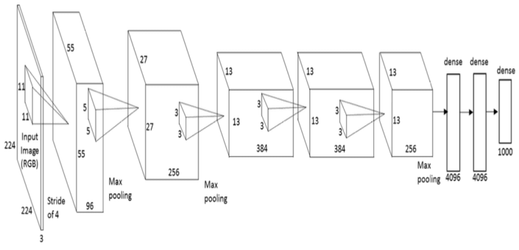
Alexnet

Slide 9
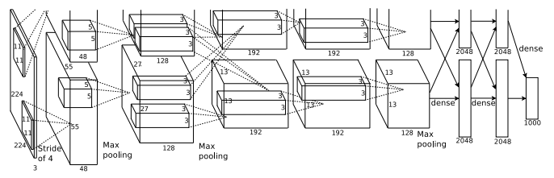
ALEXNET
AlexNet was trained simultaneously on two Nvidia Geforce GTX 580 GPUs which is the reason for why their network is split into two pipelines

Slide 10
googlenet/Inception
GoogLeNet developed by Christian Szegedy winning ILSVRC in 2014.
Pushed the top-5 error rate below 7% using a much deeper CNN network.
Utilized sub-networks, called inception modules, permitting the more efficient use of parameters.
GoogLeNet has 10 times fewer parameters than AlexNet. (6 million vs 60 million)

Slide 11
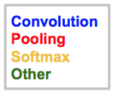
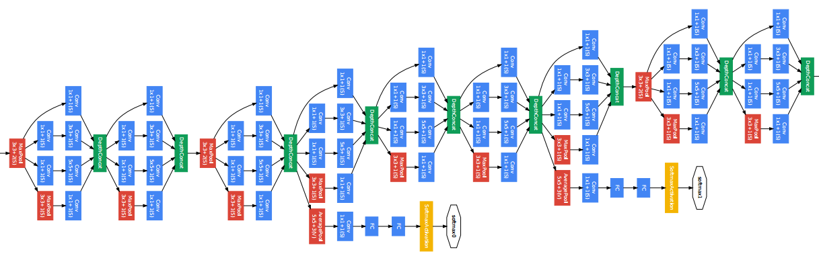
googlenet

Slide 12
Depth concat layer

Slide 13
Bottleneck layers

Slide 14
Resnet
Residual Neural Network (ResNet) by Kaiming He et al introduced a novel architecture with “skip connections” and features heavy batch normalization.

Slide 15
Skip connections

Slide 16
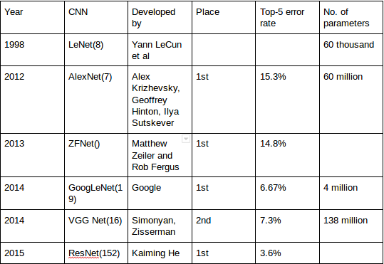
summary

